Slide 1
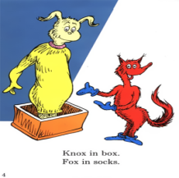
Sutherland Phonological Awareness Test-Revised

Slide 2
Tuning in………

Slide 4
Definitions
Phonemic awareness
Awareness of individual sounds.
Phonics
Knowledge of letter-sound patterns; linking sounds with letter.
Orthographic knowledge
Patterns of letters used in written English to write words (graphemes), letter- cluster knowledge (diagraphs).

Slide 5
“The SPAT”
Test-Dr Roslyn Neilson
Language , Speech and Literacy Services
Jamberoo, NSW
First published ;May,2003
Reprinted January 2005, November 2007
Copyright:2003 Roslyn Neilson
Contact details: Email:rneilson@ozemail.com.au

Slide 6
How does it all fit?

Slide 9
What is Phonological Knowledge?
Phonological Knowledge is the foundation of
our understanding of how spoken words translate into written words.
Phonological Knowledge is what we know
about the sound patterns in our words.

Slide 10
What is Phonological knowledge?
We use it in a range of ways:
Unlock the alphabet
Learn new words.
Help remember information for a short time.
When we read – segmenting, blending, manipulating sounds.
When we spell

Slide 11
Phonological Awareness
Phonological awareness is an awareness of sound and an awareness that words:
can be broken up into syllables, (hos-pit-al)
can rhyme, (can, fan, man)
can start with the same sound, (never, naughty)
can be broken up into first sound or sounds and the rime pattern eg.(s-and) (st-and),
can be formed by blending separate sounds together
eg.(f-i-s-h or f-ish makes fish)
can be segmented into separate sounds (s-a-n-d),
can be changed around by adding, removing or re-ordering sounds to make new words (minus s, sand = and, change a to e sand = send)

Slide 12
Development of Phonological Awareness
Word awareness
Syllable awareness
Rhyme awareness
Segmenting into onset-rime
Segmenting first and last sounds
Blending sounds
Segmenting words
Manipulating sounds
Early
Late

Slide 13
Assessing phonological awareness efficiently:
A knowledge of why particular skills are being assessed
What should be expected of children at different stages of development
How the task format can effect performance

Slide 14
Subtests
Subtest 1: Syllable Counting
Subtest 2: Rhyme Detection
Subtest 3: Rhyme Production
Subtest 4: CVC Blending
Subtest 5: Onset Identification
Subtest 6: Final Phoneme Identification
Subtest 7: CVC Segmentation
Subtest 8: Segmentation – Blends
Subtest 9: Deletion – Onset
Subtest 10: Deletion – Boundary Consonant
Subtest 11: Deletion – Internal Consonant
Nonword Reading and Spelling: General Comment
Subtest 12: Nonword Reading
Subtest 13: Nonword Spelling

Slide 15
SPAT-R subtests
Subtests 1-11 are auditory tests (no reading or written responses)
Assesses the following phonological awareness skills
Syllable counting
rhyme detection and production
identification of initial and final consonants
deletion of onsets
deletion of consonants within blends including consonants on the outer boundary of syllables and internal consonants

Slide 16
SPAT-R subtests
Subtests 12 and 13
involved the reading and spelling of nonwords
CVC syllable (sut)
single syllables with initial and or final consonant blends (trop, belk)
vowel digraph that can be read or spelled with analogy to a real word (vouse)
2 syllable nonword with consonant blends (mitspon)
3 syllable nonword without intra-syllabic consonant blends (despintal)

Slide 17
Materials needed for the SPAT
The SPAT-R Manual
The Stimulus Sheet Booklet
Test booklet or a screening scoresheet
2 forms – form A and form B- recommended that a different form is used if a child is retested on the SPAT-R within 6 months

Slide 18
The Stimulus sheet booklet
Subtest/s | Description
1 | Drums for syllable counting
2 | Pictures for rhyme detection
7 and 8 | Boxes for phoneme segmentation
12 | Nonwords:reading
13 | Instructions for nonword spelling. This sheet is not shown to the child.

Slide 19
Demonstration, Practice and Test Items
Subtests 1-11
1 demonstration item
1 practice item
4 test items
Discontinuation Guidelines:
Discontinue any individual subtest if:
Child does not respond to teaching on the practice items
AND fails the first 2 test items

Slide 20
Demonstration, Practice and Test Items
Subtest 12 and 13
8 test items
no demonstration or practice items
Discontinuation Guidelines:
Discontinue either subtest if:
Child has no strategies for attempting the first two items
The child seems stressed
Continue if:
incorrect response, but signs of partial processing

Slide 21
1.Syllable counting….
Orients the child to the process of attending to the sounds in words, rather than to their meaning.
When finding this subtest difficult, a student may show some articulation problems, especially with multisyllabic words.

Slide 22
2.Rhyme detection…..
Undemanding in terms of cognitive requirements and memory load
Uses pictures to support the student’s memory for the rhyming words

Slide 23
3.Rhyme production
Very sensitive to the presence of oral language difficulties
In the lower years of schooling it is often a marker for students with reading difficulties
Students who do not have awareness of rhyming features of language will often give semantically related answers e.g. night, fight, pillow
If students are ok on rhyme detection task, but not on rhyme production task, this may indicate the effects of word retrieval difficulties

Slide 24
4.CVC blending…..
This task has a high correlation to the SPAT-R total score. This means that if the student has difficulties on this task, they are likely to score poorly overall.
If students perform strongly on this subtest it can indicate a students strong emerging control over phonological awareness

Slide 25
5.Onset identification
“Children who cannot identify onsets early in their school career are particularly at risk for experiencing difficulties in their literacy development”- Ref: Byrne,1998
Potential difficulties with learning the alphabet
Phoneme vs letter

Slide 26
6.Final phoneme identification
It cannot be assumed that once a child can identify the sound at the beginning of a word, the sound at the end of a word will be equally accessible
Phoneme vs letter

Slide 27
7.CVC segmentation
Segmentation and blending are complementary skills
“Say it and move it technique”
Potential problems with this test-
1.identification of a nasal consonant after a vowel
2. Students who are able to visualise the spelling of the words may possibly be confused about whether they are working with sounds or letters

Slide 28
8.Segmentation blends
In the lower years of schooling students find it difficult to identify the separate sounds in consonant blends. This is normally a late developing phonological skill (Treiman,1993)

Slide 29
9.Deletion-onset
A robust indicator of phonological awareness development –Ref:Catts,Fey,Zhang&Tomblin,2001
The emergence of this skill by the end of YOS 1 or early in YOS 2 is a good indicator that a child is making reasonable progress
If a child is unable to access and manipulate the sound of the rime unit as an independent chunk of a word, they may experience difficulties with identifying word families in spelling tasks

Slide 30
10.Deletion- boundary consonant
Issue of task complexity- leading to errors
Requires the student to be aware of the internal sounds in consonant blends
Students with less experience may delete the whole onset- this indicates that the separate sounds in the consonant blend are not particularly salient to them

Slide 31
11.Deletion –internal consonant
Student has to segment , delete and then blend phonemes

Slide 32
12.Non-word reading
Use of the nonword spelling analysis
Allows clear demonstration of consonant blend segmentation skills
Is particularly sensitive to emerging skills of phoneme segmentation in the early years of school

Slide 33
13.Nonword spelling
Analysis of non – word spelling form

Slide 34
So what?
To clarify student specific needs-
Analysis of the data
Use of normative table
Links with other data
Reference to developmental sequence
Determine priorities for support and practice
Review regularly – rate of gain

Slide 35
We must not, in trying to think about how we can make a big difference, ignore the small daily differences we can make which, over time, add up to big differences that we often cannot foresee.
Ref:Marian Wright Edelman

Slide 36
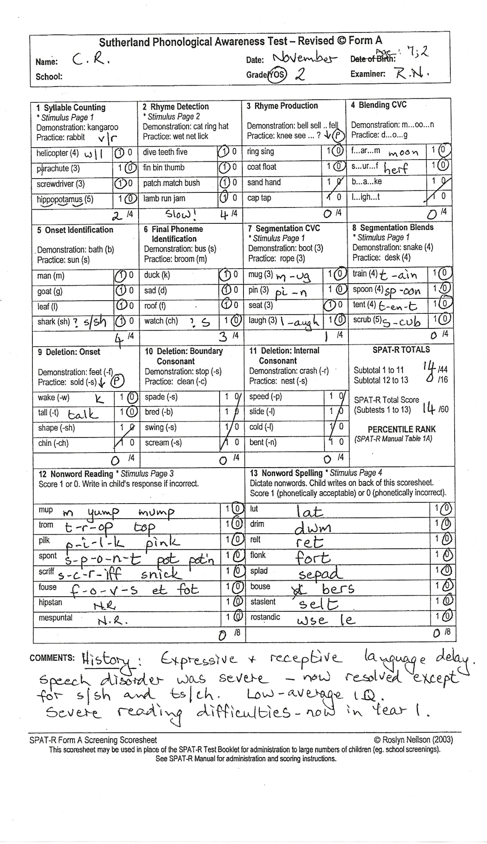

Slide 37
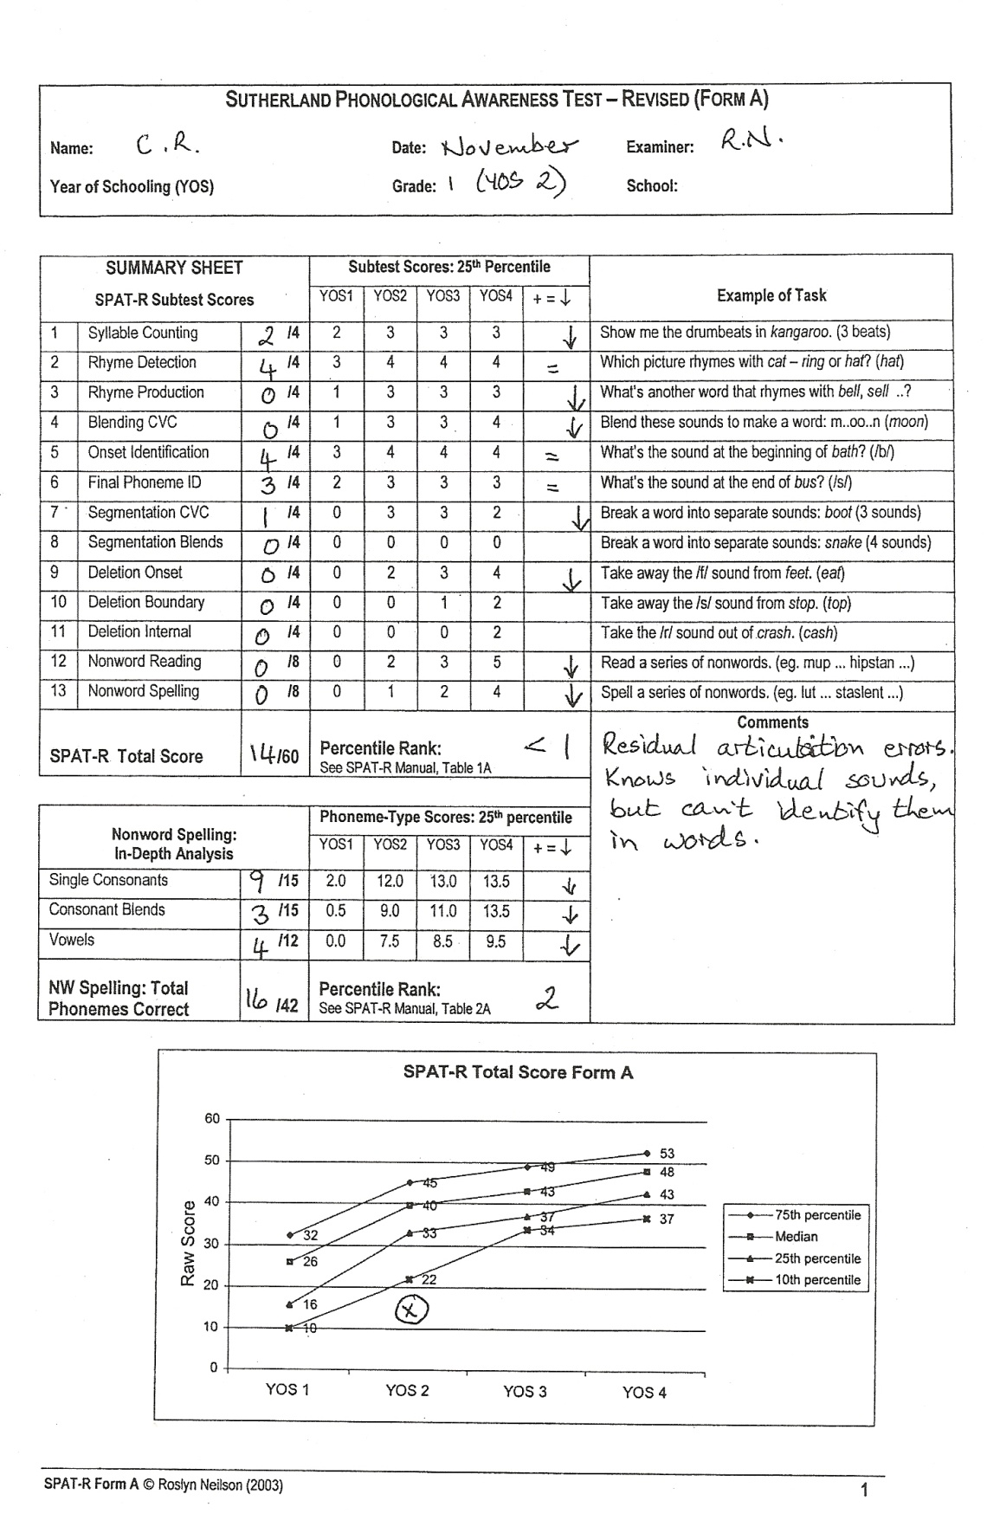

Slide 38
